Slide 1
Minimization of Cumulative Battery Aging
Grid-Based Approach
Raja Selvakumar, Yaser Marafee, Bryant Huang

Slide 2
Agenda
Motivation
Literature
Methodology
Results & Discussion
Future Work

Slide 3
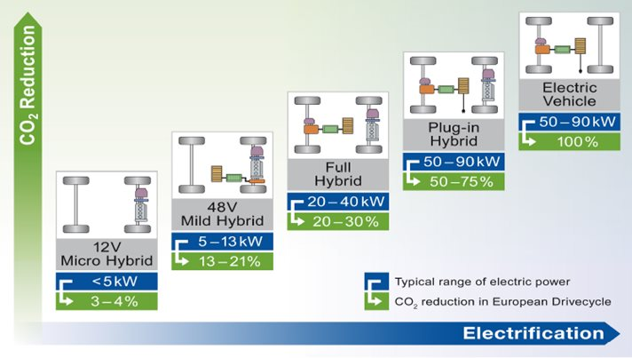
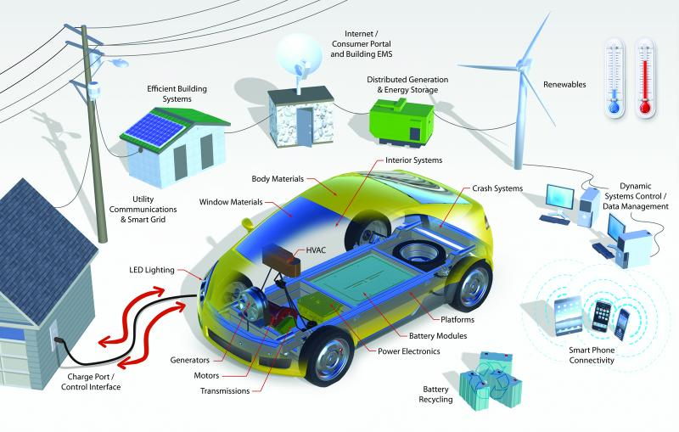
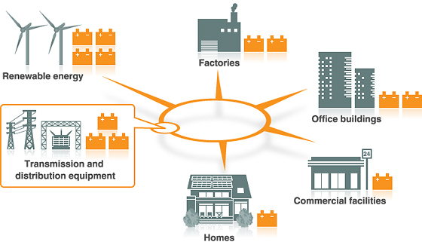
Motivation
Electrification of automotive transportation
Renewable energy integration
Notes:
Durability of the battery is critical issue to accomplish these goals

Slide 4
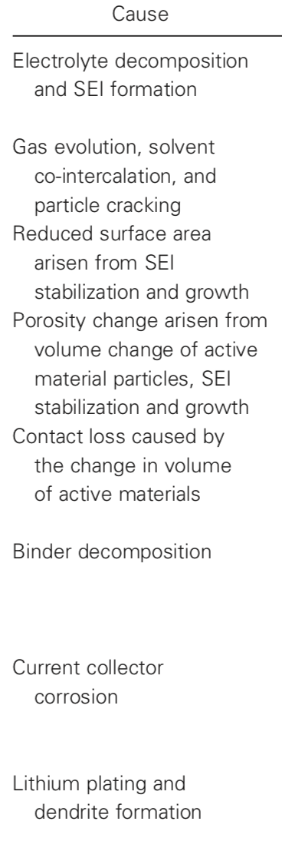
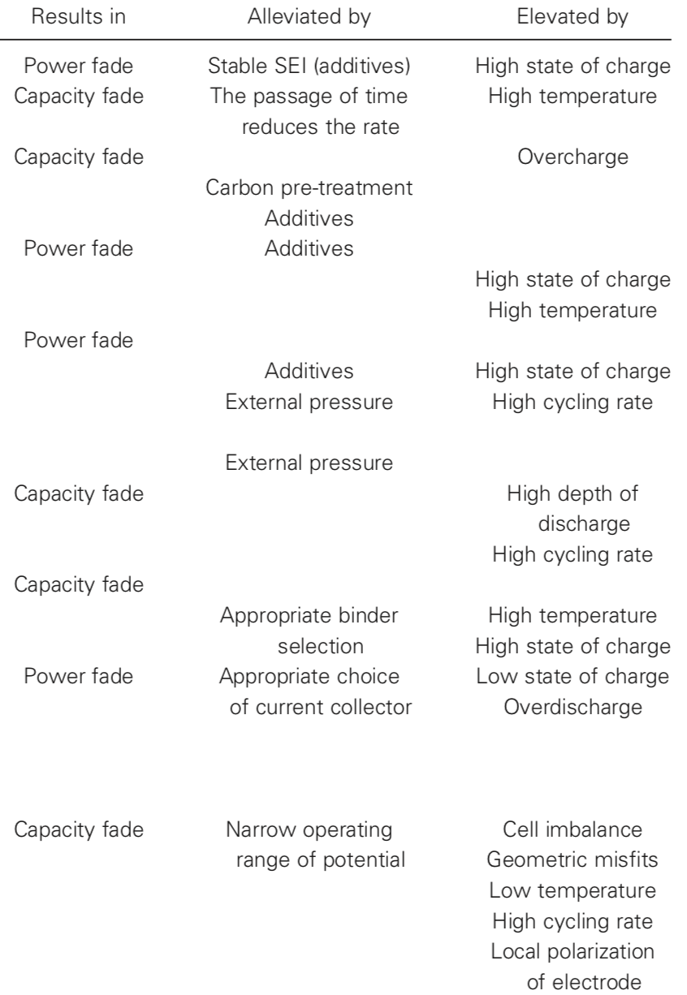
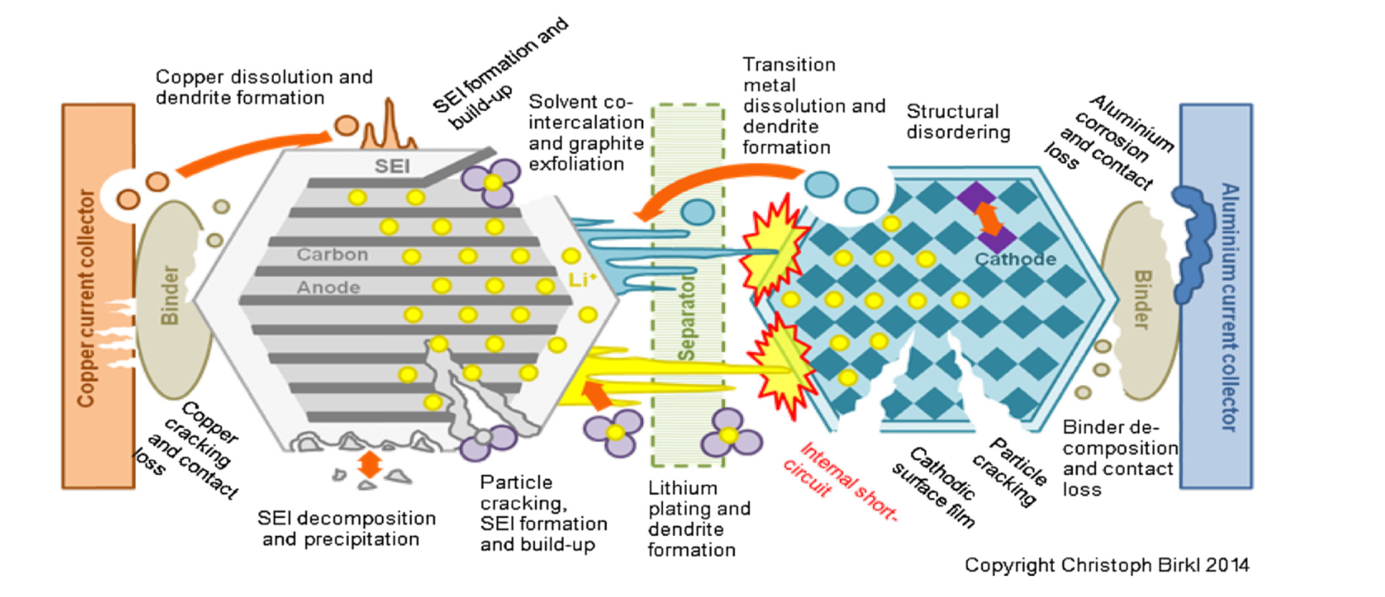
Motivation (cont’d)
Degradation mechanism
Causes of capacity / power fade
Int. J. Energy Res. 2017; 41:1963–1986 © 2017 John Wiley & Sons, Ltd.
Notes:
Over designing
If we can optimize the energy distribution to demand, we can not only reduce the cost but also minimize the battery aging

Slide 5
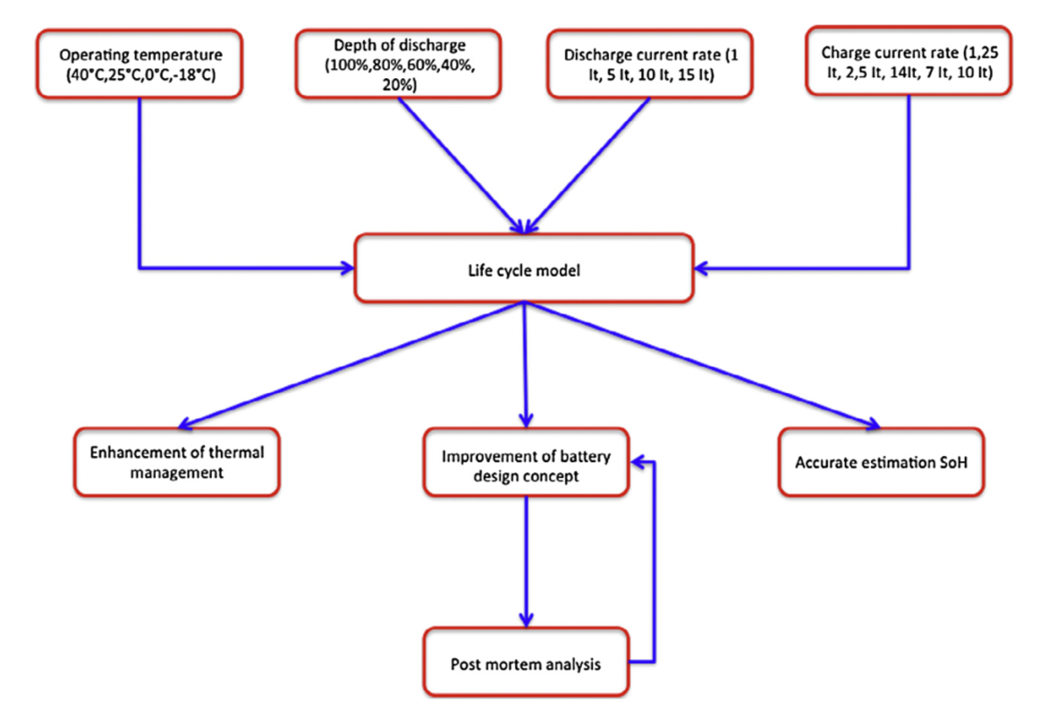

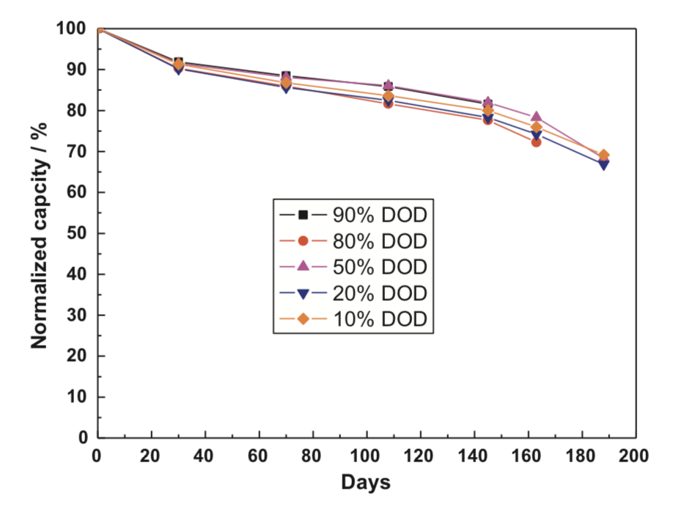
Literature
Test methodology
Influence of DOD & cycle time
Wang, J., et al. (2011). "Cycle-life model for graphite-LiFePO4 cells."
N. Omar et al. / Applied Energy 113 (2014) 1575–1585

Slide 6
Problem Formulation
P_{0i}(k)
A_{h} represents the current throughput through the cell at time step k
R_{B}
∓
V_{oc}
Equivalent circuit model (ECM)
d(k)
Wang, J., et al. (2011). "Cycle-life model for graphite-LiFePO4 cells."

Slide 7
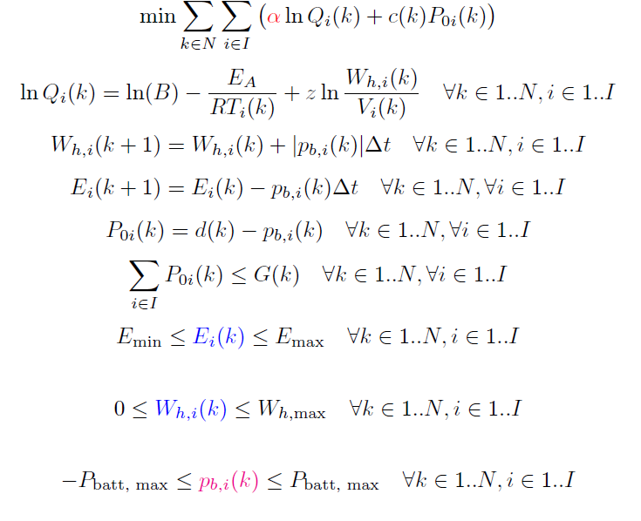
Methodology
Added cost of drawing power from grid
2 states (assuming temperature is fixed)
1 control variable

Slide 8
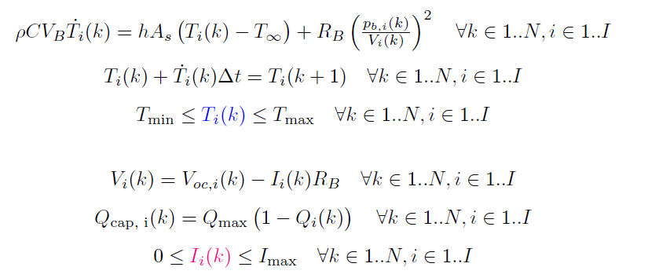
Temperature dynamics

Slide 9

DP Formulation
Let V(k) represent the cumulative capacity fade and power generation from time step k to total time N. We define control variable p_{b,i}(k) as u_{k} and state variables E_{i}(k), W_{h,i}(k) as x_{k,1} and x_{k,2} (for all k and i):
with the boundary condition V(N+1) = 0.

Slide 10
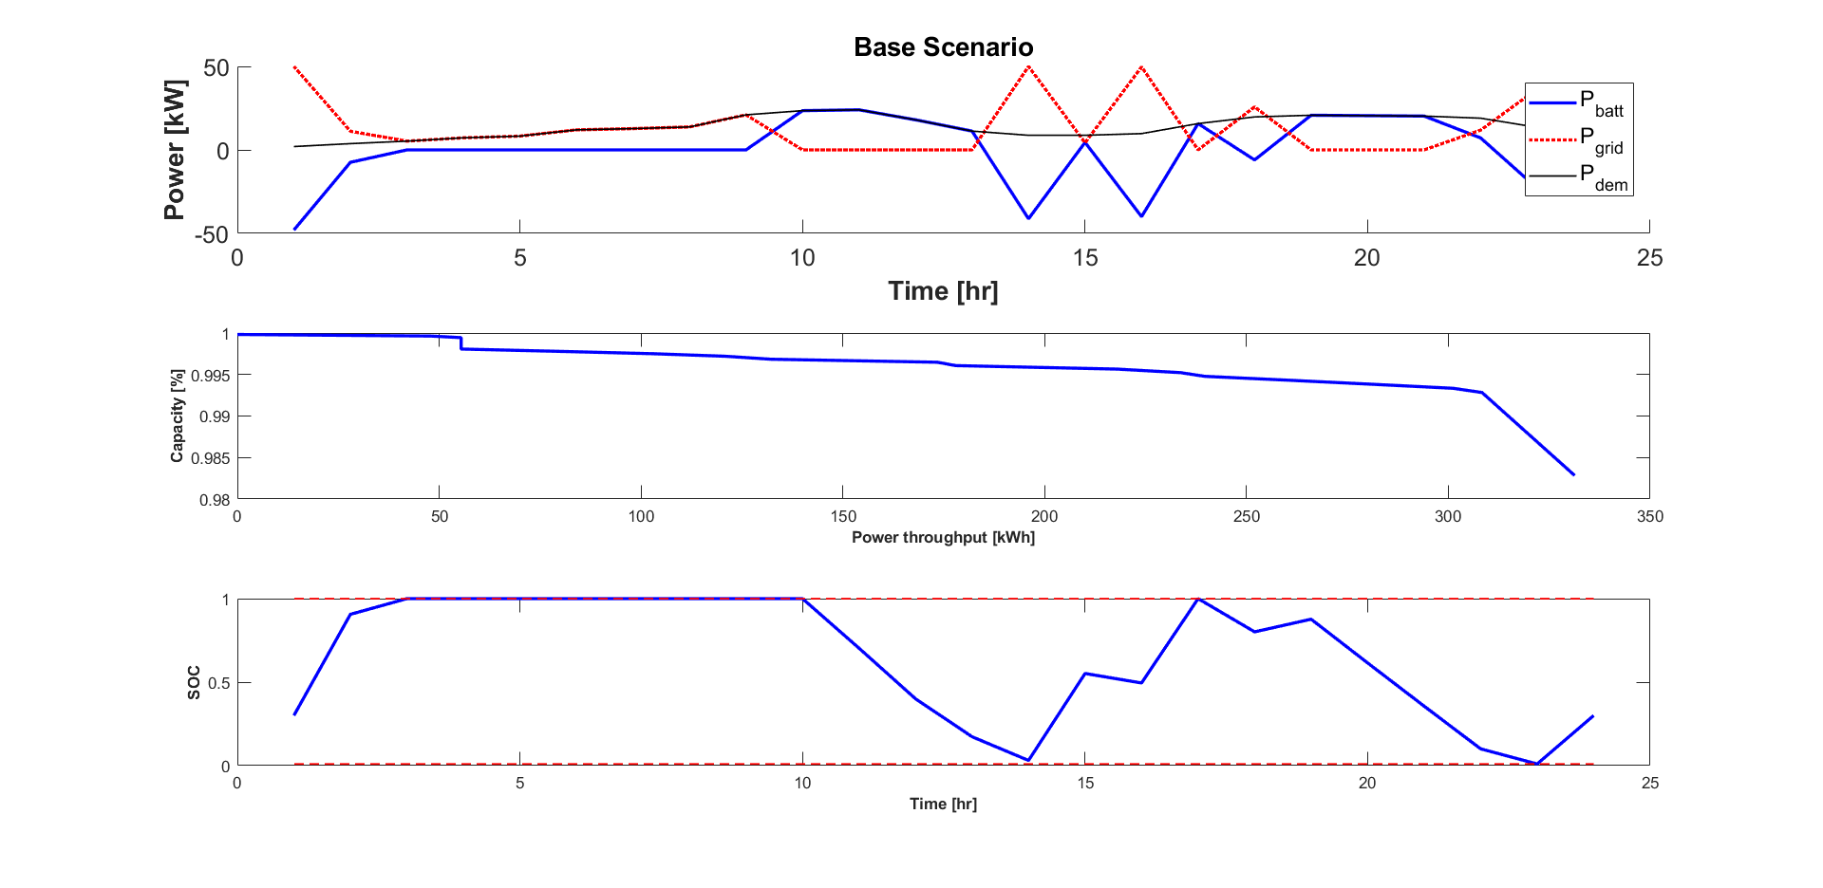
Results: Base case

Slide 11
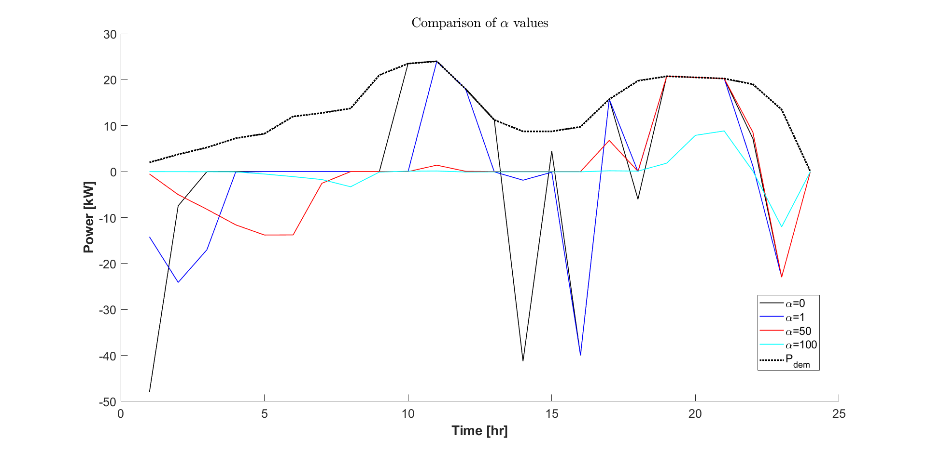
Results of varying ⍺

Slide 12
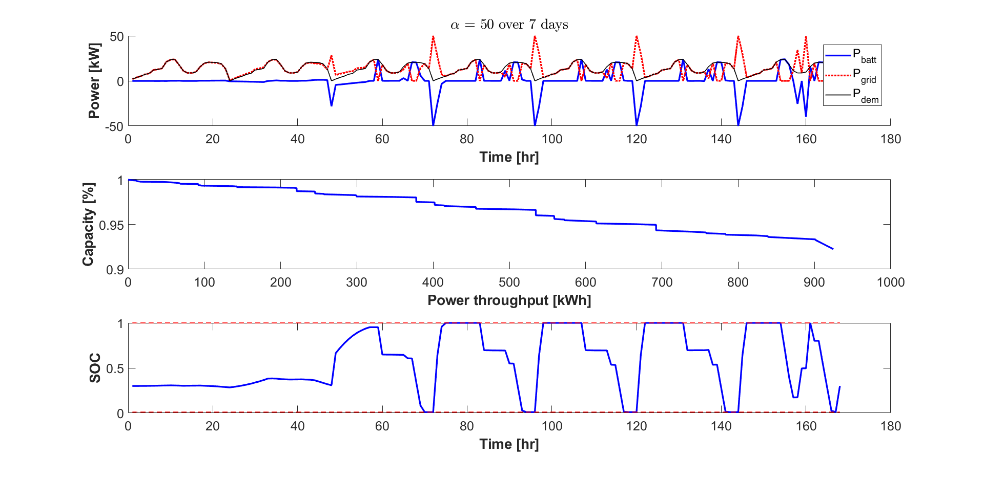
Results: Week long optimization

Slide 13
Discussion
Optimal to use the battery at high demand and high c-rates rather than continual battery operation
Capacity fade is less with higher charge throughputs (Wh^{z})
Over long time periods, the DP minimizes initial battery usage

Slide 14
Future Works
Challenges
Temperature consideration
Add fleet of batteries
Grid power and demand fluctuations
Computationally intensive
Capacity loss models are not robust with scaling

Slide 15
THANKS!
Any questions?

